Slide 1



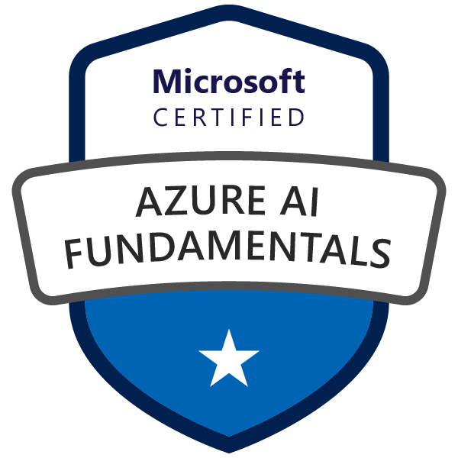


Microsoft Azure AI Fundamentals
Mike Pfeiffer
Microsoft Azure MVP

Slide 2


Tim Warner
Nashville, TN, US
Central time zone
Microsoft Certified Trainer (MCT)
MVP (Cloud & Datacenter Management)
Twitter: @TechTrainerTim
Badges: TechTrainerTim.com

Slide 3
Session 1 of 2 Learning Goals
Introduction
Describe Artificial Intelligence (AI) Workloads
Review Responsible AI
Describe Machine Learning
Work with Computer Vision Workloads

Slide 4
Session 2 of 2 Learning Goals
Vision
Face
Language
Text Analytics
Translator
Speech
LUIS
Conversational AI Workloads
QnA Maker
Azure Bot Framework
AI-900 practice questions

Slide 5
Session 2 of 2 Learning Goals
Conversational AI
QnA Maker
Azure Bot Framework
Exam AI-900 practice questions

Slide 6
Course Materials
timw.info/ai900cs

Slide 7
Tim's Certification Study Pyramid
Interdependence
Content knowledge
Practical application
Test-taking skills

Slide 8
Expectations
This is a "crash course"
Plan to review these materials more than once
Five-minute break at midpoint
Please ask/answer questions and provide feedback in the Q/A panel, not the group chat

Slide 9
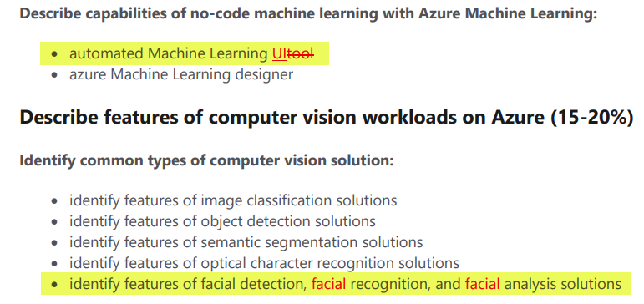
2021 AI-900 Exam Updates
Microsoft Worldwide Learning (WWL) revisits exam's objectives every 2 months
AI-900 was last updated October 22, 2020
The updates were trivial and cosmetic

Slide 10
AI-900 Practice Questions

Slide 11
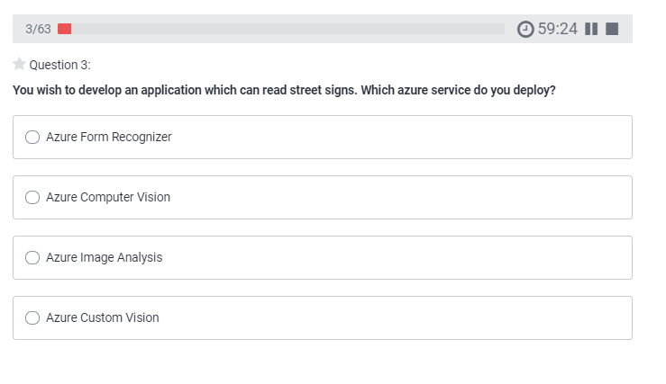
AI-900 Practice Question
timw.info/udemy

Slide 12
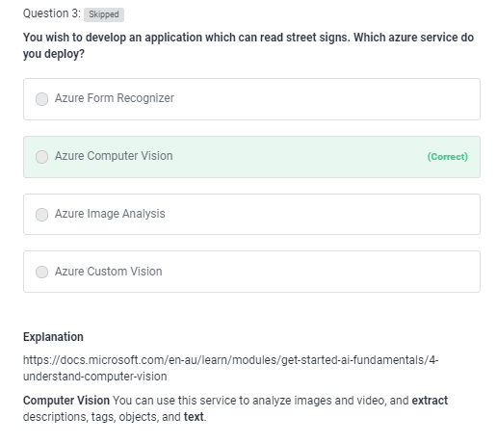
AI-900 Practice Question
timw.info/udemy

Slide 13
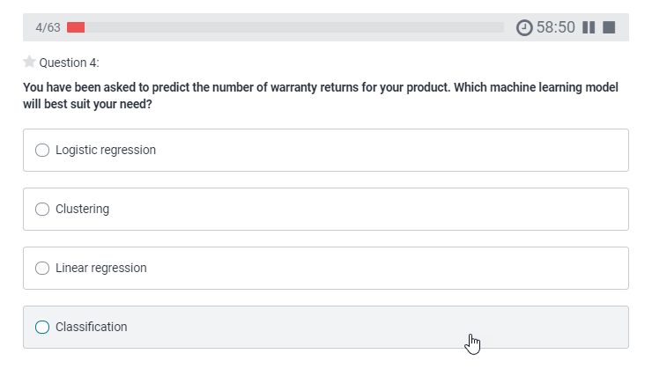
AI-900 Practice Question
timw.info/udemy

Slide 14
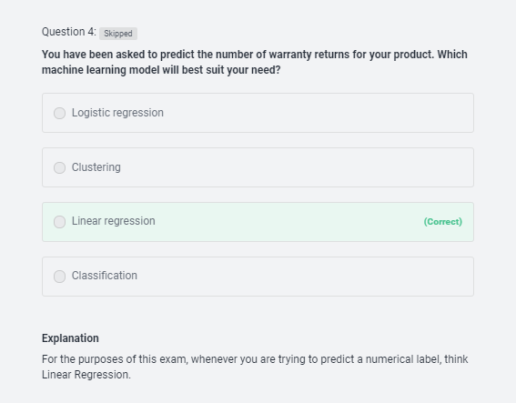
AI-900 Practice Question
timw.info/udemy

Slide 15
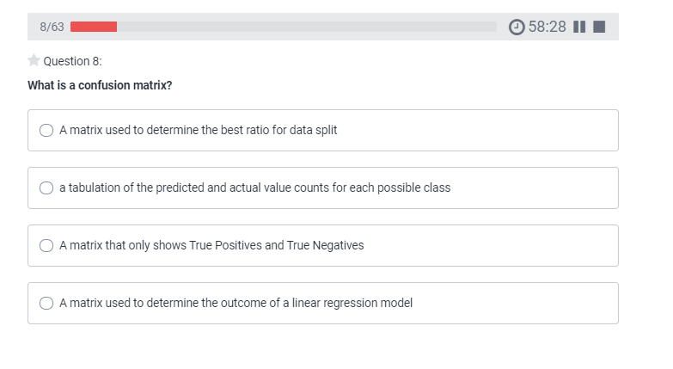
AI-900 Practice Question
timw.info/udemy

Slide 16
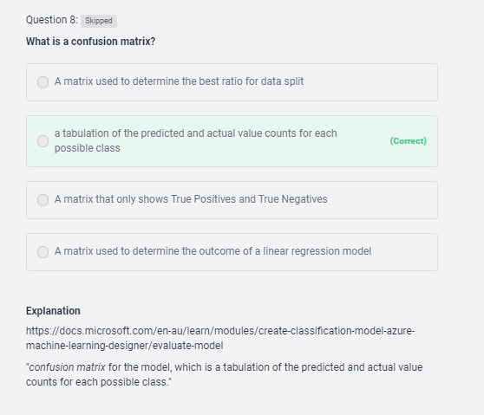
AI-900 Practice Question
timw.info/udemy

Slide 17
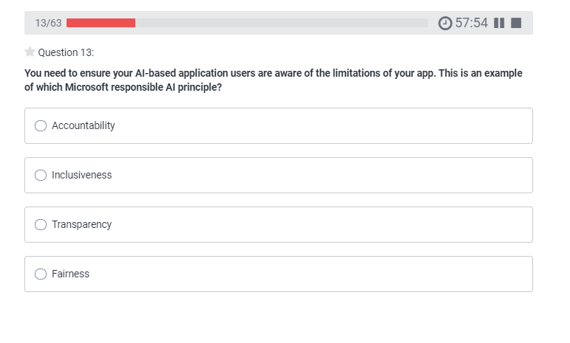
AI-900 Practice Question
timw.info/udemy

Slide 18
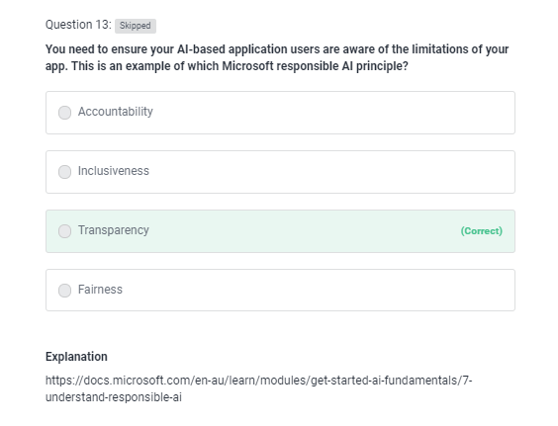
AI-900 Practice Question
timw.info/udemy

Slide 19
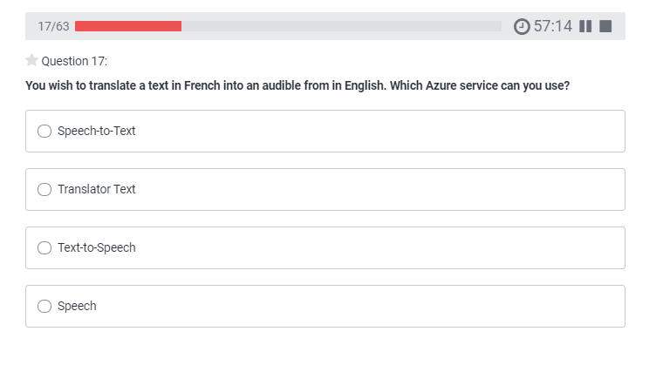
AI-900 Practice Question
timw.info/udemy

Slide 20
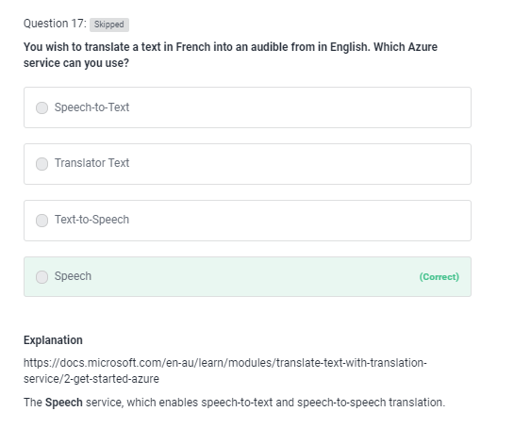
AI-900 Practice Question
timw.info/udemy

Slide 21
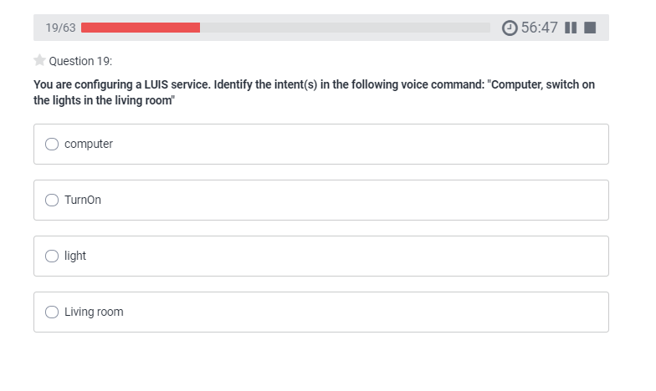
AI-900 Practice Question
timw.info/udemy

Slide 22
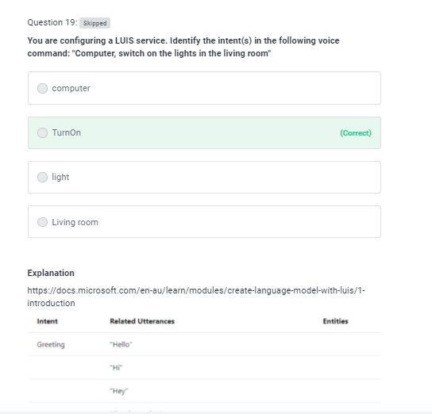
AI-900 Practice Question
timw.info/udemy

Slide 23
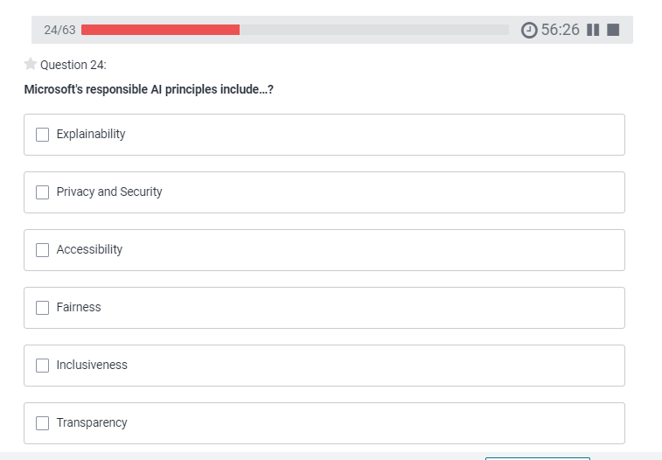
AI-900 Practice Question
timw.info/udemy

Slide 24
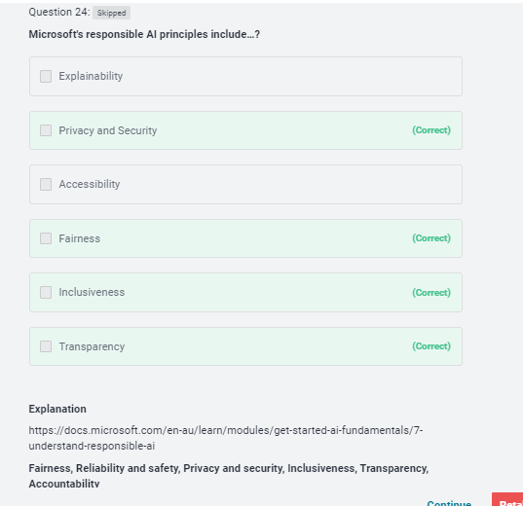
AI-900 Practice Question
timw.info/udemy

Slide 25
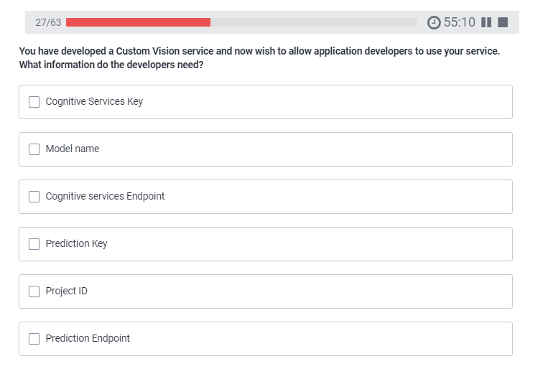
AI-900 Practice Question
timw.info/udemy

Slide 26
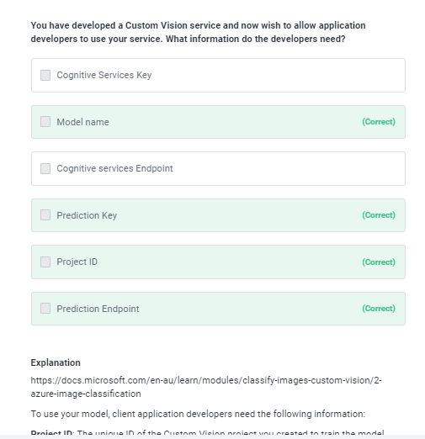
AI-900 Practice Question
timw.info/udemy

Slide 27
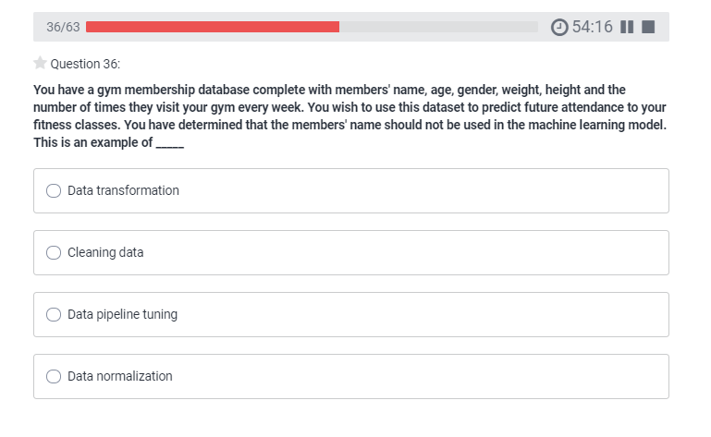
AI-900 Practice Question
timw.info/udemy

Slide 28
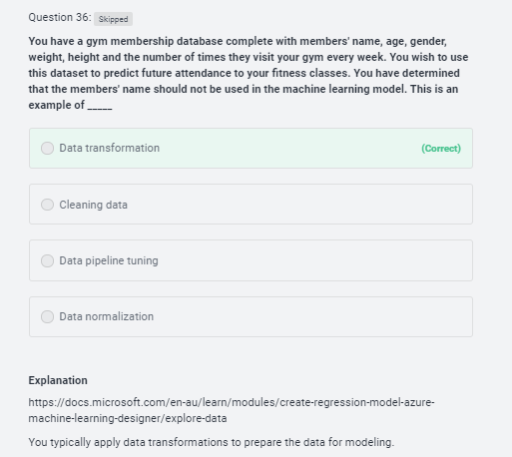
AI-900 Practice Question
timw.info/udemy

Slide 29
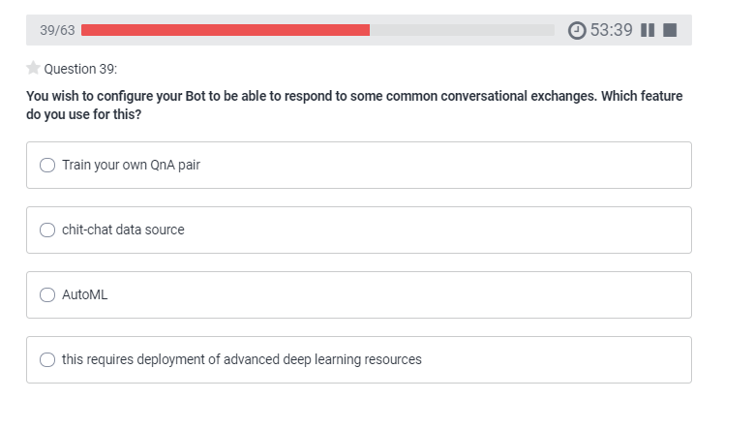
AI-900 Practice Question
timw.info/udemy

Slide 30
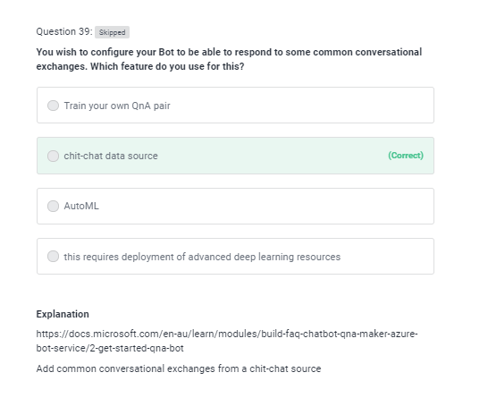
AI-900 Practice Question
timw.info/udemy

Slide 31
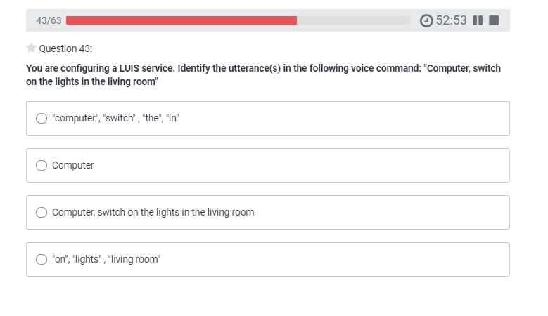
AI-900 Practice Question
timw.info/udemy

Slide 32
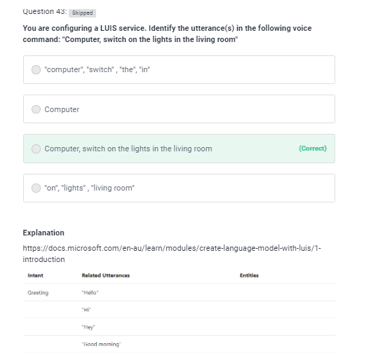
AI-900 Practice Question
timw.info/udemy

Slide 33
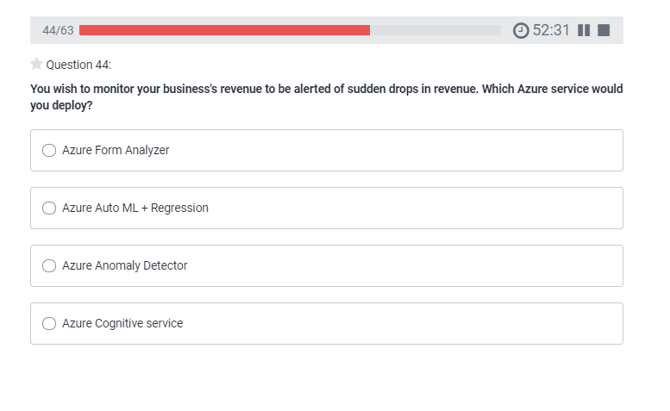
AI-900 Practice Question
timw.info/udemy

Slide 34
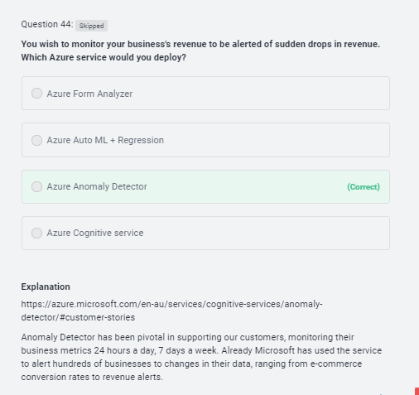
AI-900 Practice Question
timw.info/udemy

Slide 35
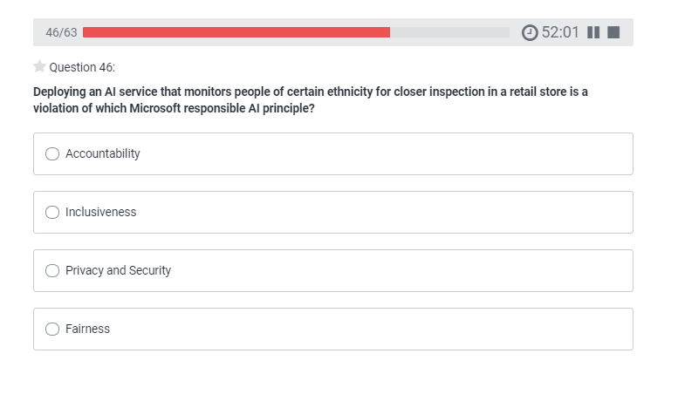
AI-900 Practice Question
timw.info/udemy

Slide 36
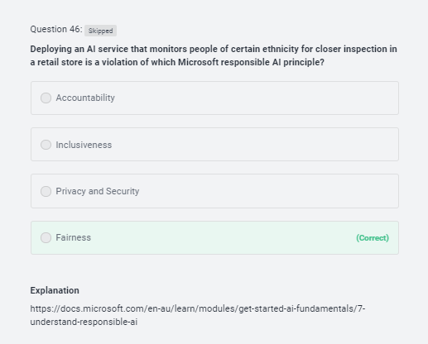
AI-900 Practice Question
timw.info/udemy

Slide 37
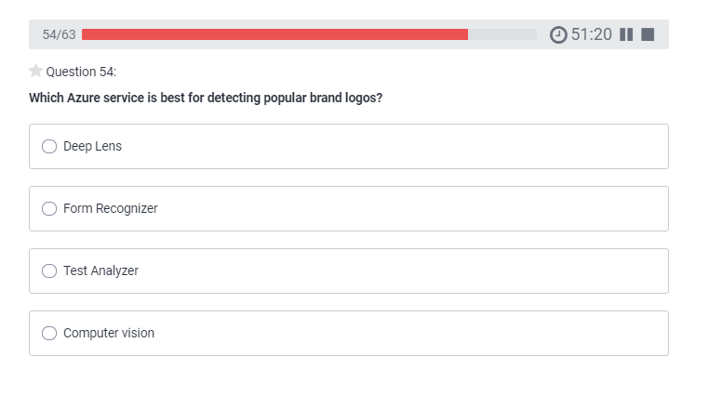
AI-900 Practice Question
timw.info/udemy

Slide 38
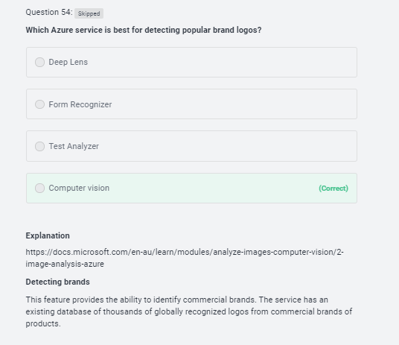
AI-900 Practice Question
timw.info/udemy

Slide 39
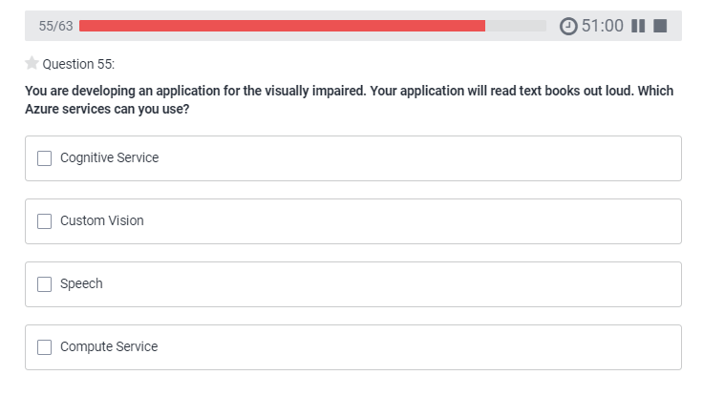
AI-900 Practice Question
timw.info/udemy

Slide 40
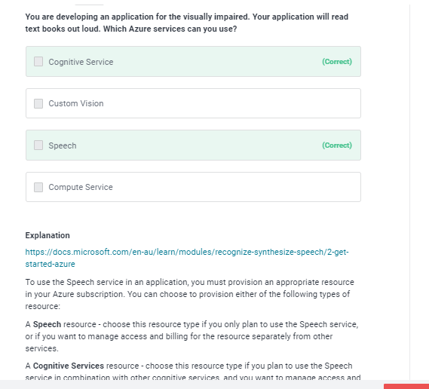
AI-900 Practice Question
timw.info/udemy

Slide 41
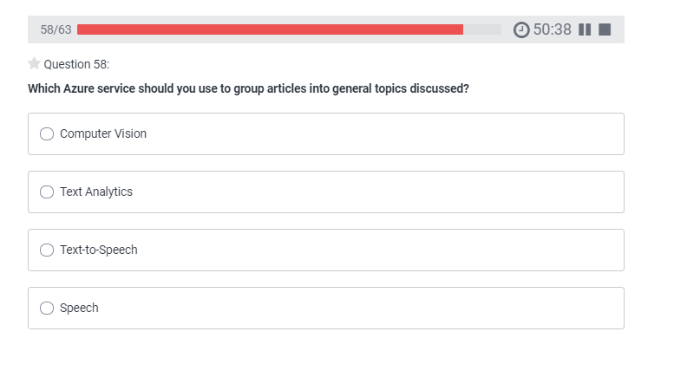
AI-900 Practice Question
timw.info/udemy

Slide 42
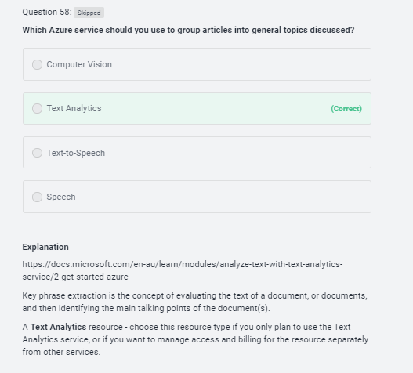
AI-900 Practice Question
timw.info/udemy

Slide 43
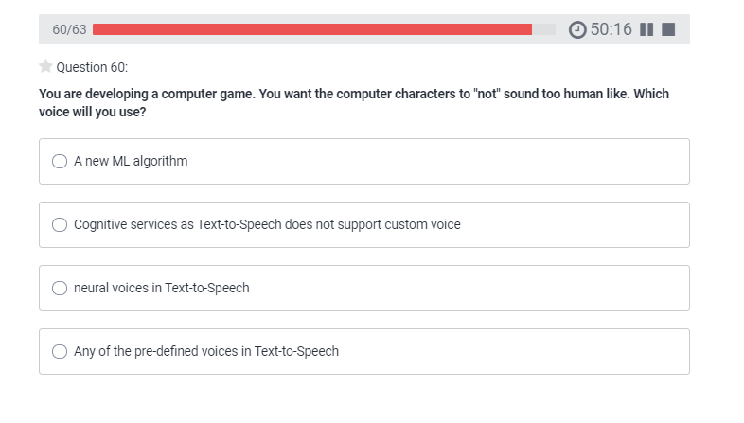
AI-900 Practice Question
timw.info/udemy

Slide 44
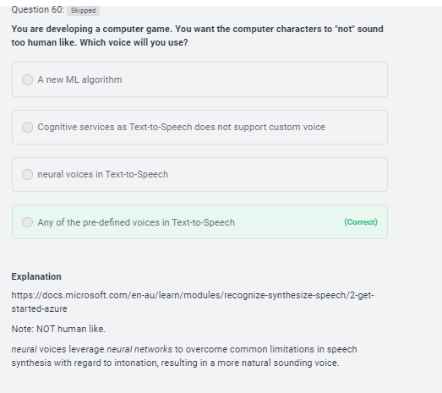
AI-900 Practice Question
timw.info/udemy

Slide 45
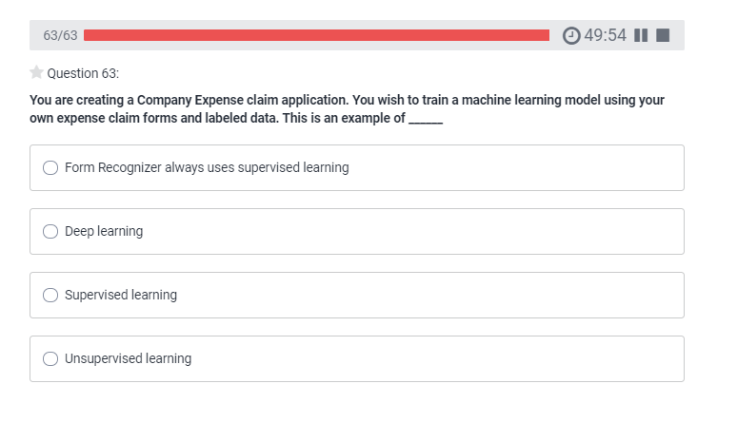
AI-900 Practice Question
timw.info/udemy

Slide 46
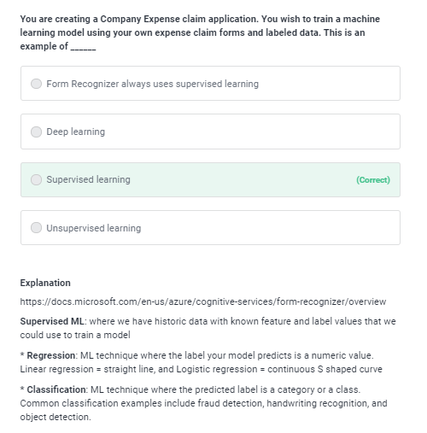
AI-900 Practice Question
timw.info/udemy

Slide 47
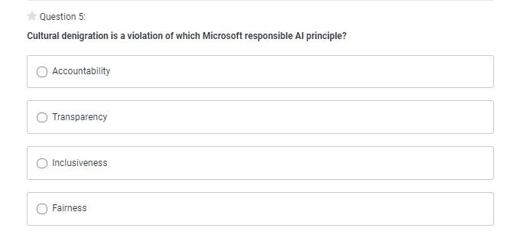
AI-900 Practice Question
timw.info/udemy

Slide 48
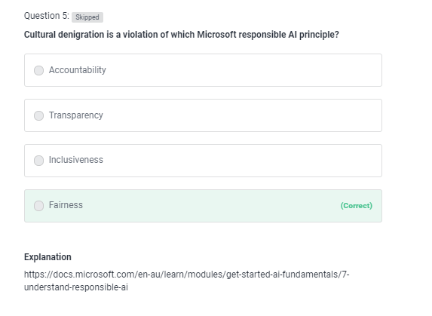
AI-900 Practice Question
timw.info/udemy

Slide 49
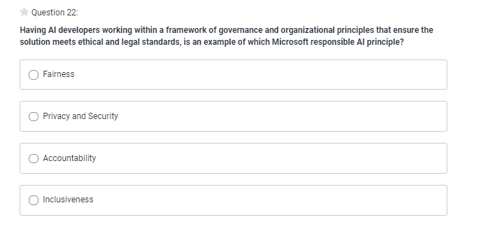
AI-900 Practice Question
timw.info/udemy

Slide 50
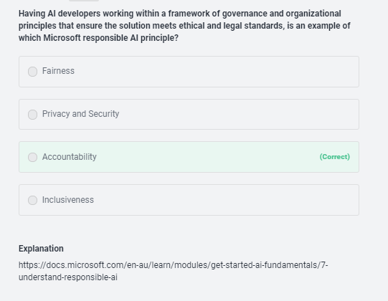
AI-900 Practice Question
timw.info/udemy

Slide 51
Thank you!
Course materials: timw.info/ai900cs
Twitter: @TechTrainerTim
Courses: timw.info/ps
Web: TechTrainerTim.com

Slide 52
Fundamental Terminology

Slide 53
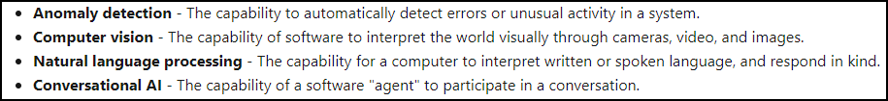
Artificial Intelligence (AI)
Any technique that enables computers to mimic human intelligence
https://timw.info/2bdb4

Slide 54
Machine Learning (ML)
Subset of AI that includes techniques that enable machines to improve at tasks with experience
The system "learns" without being explicitly programmed to do so
Supervised
Unsupervised

Slide 55
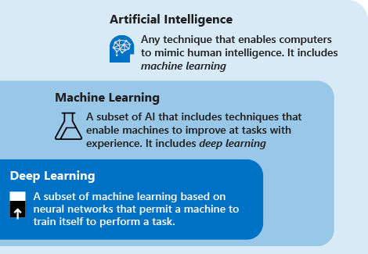
AI Schema
https://timw.info/c7769

Slide 56
Azure AI Technology Stack Overview

Slide 57
Azure AI Stack
Apache Spark on Azure (MMLSpark)
HDInsight
Databricks
Azure Machine Learning
Azure Cognitive Services
Azure Cognitive Search
Azure Bot Service

Slide 58
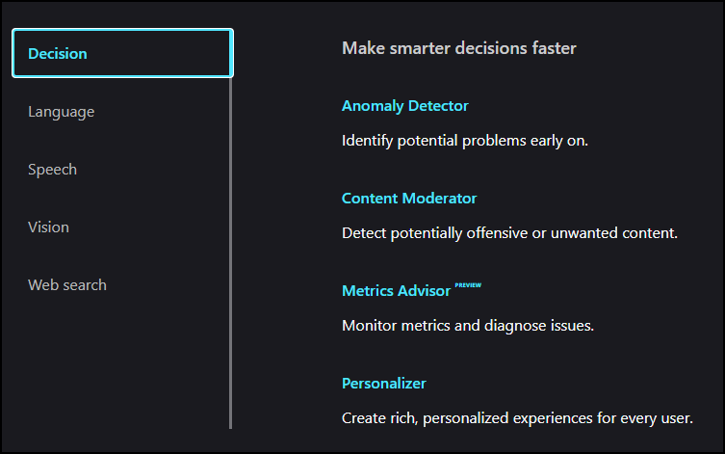
Azure Cognitive Services
Prediction
https://timw.info/b3f9f

Slide 59
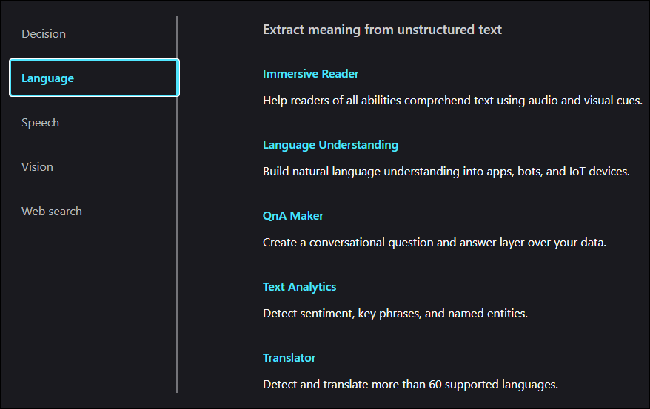
Azure Cognitive Services
Natural Language Processing (NLP)
https://timw.info/b3f9f

Slide 60
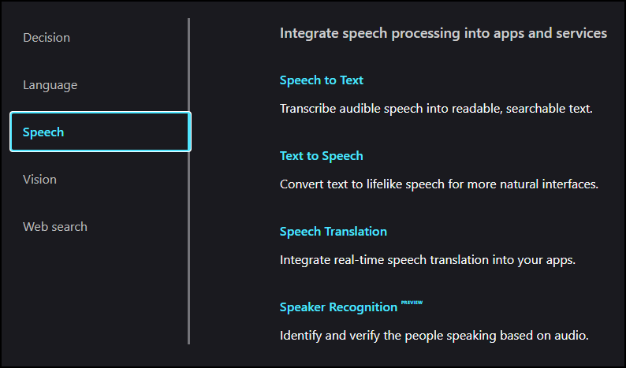
Azure Cognitive Services
Conversational AI
https://timw.info/b3f9f

Slide 61
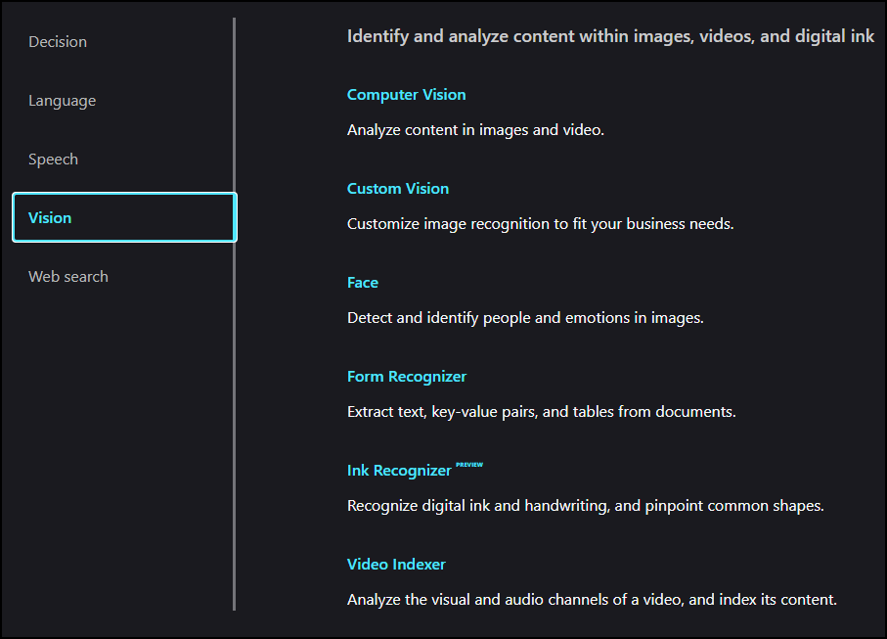
Azure Cognitive Services
https://timw.info/b3f9f

Slide 62
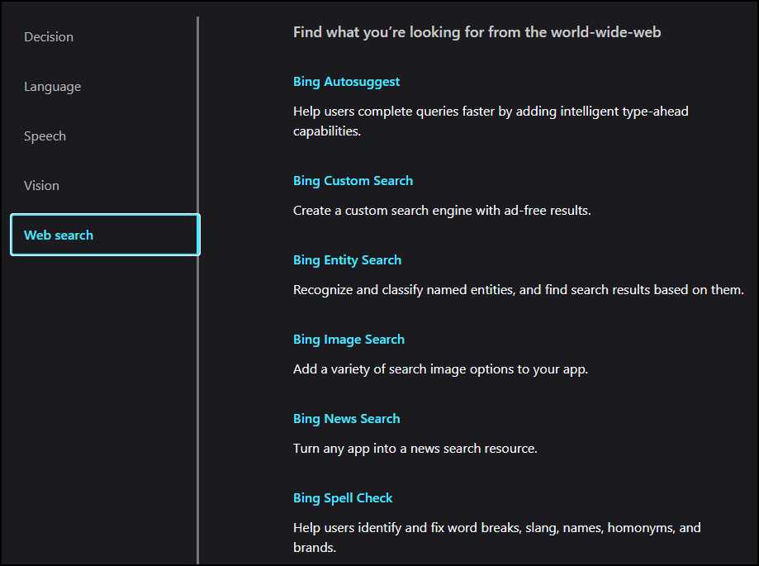
Azure Cognitive Services
https://timw.info/b3f9f

Slide 63
Use Cases

Slide 64
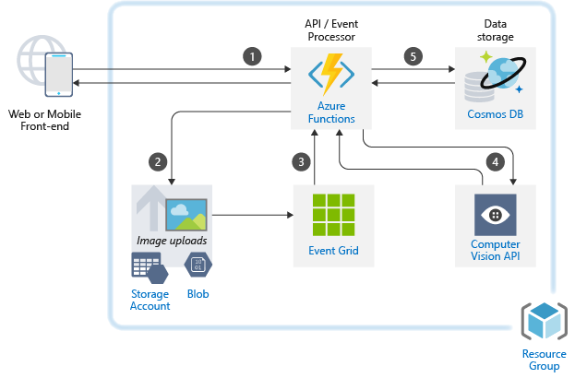
Image Classification
https://timw.info/caa25

Slide 65

Newsfeed Ingestion
https://timw.info/c0015

Slide 66

Internet of Things (IoT)
https://timw.info/3f2c0

Slide 67
Responsible AI

Slide 68
Microsoft's Position on AI Use
"We are committed to the advancement of AI driven by ethical principles that put people first."
Reference: https://timw.info/01bdb

Slide 69

Responsible AI Principles
AI systems should treat all people fairly
AI systems should perform reliably and safely
AI systems should be secure and respect privacy
AI systems should empower everyone and engage people
AI systems should be understandable
Examples: https://timw.info/rai
People should be accountable for AI systems
https://timw.info/880e4

Slide 70


Responsible AI
Compliance Manager
https://timw.info/84db2

Slide 71
Azure Machine Learning

Slide 72
Machine Learning (ML)
Subset of AI that includes techniques that enable machines to improve at tasks with experience
Supervised
Regression: Predicting numeric data
Classification: Organizing non-numeric, discrete data
Unsupervised
Clustering
Pattern recognition

Slide 73

ML Model
Feature (Descriptive attribute) engineering vs. feature selection
Label: What you're trying to forecast
https://timw.info/37a04

Slide 74

Azure Machine Learning Service
https://timw.info/de625

Slide 75

Blob Storage and Data Lake Storage
CSV, JSON
https://timw.info/772f8

Slide 76

Azure ML Dataset & Datastore
A reference to your dataset in Azure storage
Authenticated context
https://timw.info/a1df2

Slide 77

Azure ML Dataset & Datastore
https://timw.info/5a306

Slide 78

Azure ML Pipeline
https://timw.info/d572e

Slide 79

HTTP Methods
https://timw.info/cc6b1

Slide 80

How a REST API Works
CRUD
https://timw.info/a850d

Slide 81


How a REST API Works
https://timw.info/d7a91

Slide 82

Azure Automated ML
Build ML models in a much more efficient manner
https://timw.info/aai3

Slide 83

Validating AutoML Models
Confusion matrix
https://timw.info/26d20

Slide 84

Validating AutoML Models
Confusion matrix
https://timw.info/26d20

Slide 85
Computer Vision

Slide 86
Computer Vision Capabilities
Detect objects in images
Optical Character Recognition
Apply content tags to images
Detect faces in images

Slide 87
Software Development Kits (SDKs)
.NET
Python
Java
Node
Go

Slide 88
Exam AI-900 Strategy

Slide 89
Tim's Certification Study Pyramid
Interdependence
Content knowledge
Practical application
Test-taking skills

Slide 90
Item Types

Slide 91

Single Answer Multiple Choice

Slide 92

Multiple Answer Multiple Choice

Slide 93
Repeated Scenario
You need to move an Azure VM to another hardware host.
Solution: You redeploy the VM.
Does this solution meet the goal?
Yes
No

Slide 94
Repeated Scenario
You need to move an Azure VM to another hardware host.
Solution: You enable boot diagnostics.
Does this solution meet the goal?
Yes
No

Slide 95

Select and Place

Slide 96

Build List and Reorder

Slide 97

Active Screen/Fill in the Blank

Slide 98

Case Study

Slide 99






Performance-Based Lab

Slide 100
Microsoft Online Testing

Slide 101
Tim's Online Testing Video (YouTube)
timw.info/online

Slide 102

Microsoft Online Testing Process

Slide 103

Microsoft Online Testing Process

Slide 104

Microsoft Online Testing Process

Slide 105

Microsoft Online Testing Process

Slide 106

Microsoft Online Testing Process

Slide 107

Microsoft Online Testing Process

Slide 108

Microsoft Online Testing Process

Slide 109
Azure Cognitive Services

Slide 110


First Things First
Cognitive Services multi-service account
Azure Functions
https://timw.info/89e3b

Slide 111


How To Know Cognitive Services

Slide 112


How To Know Cognitive Services

Slide 113
Computer Vision
Digital Asset Management (DAM) solution for image data
Detect objects and features
Detect corporate brands/logos
Describe an image
Optical character recognition (OCR)
Generate thumbnail
https://timw.info/bb965

Slide 114

Face
Facial recognition
Facial verification
Emotion recognition
Person Group containers:
Person Group (10,000 persons)
Large Person Group (1M persons)
https://timw.info/31118

Slide 115

Video Indexer
Extract meaning from video and audio files
Index faces and spoken words
Great for making content available to vision- or hearing-challenged users
Content moderation
Azure Media Services
Encoding
https://timw.info/d0b4b

Slide 116

Content Moderator
Checks text, image, and video content for potentially undesirable content
Profanity
Adult or "racy" content
https://timw.info/7eec2

Slide 117

Speech
Speech-to-text: Transcribe audio from >40 languages
Speaker recognition:
Voice signature
https://timw.info/18876

Slide 118

Text Analytics
Language detection
Sentiment analysis
Entity extraction
People
Places
Organizations
Objects
Translator: 60 languages
https://timw.info/87290

Slide 119

Azure Cognitive Search
https://timw.info/c6ab1

Slide 120

Bing Web Search
Retrieve answers from Bing search engine
Web pages
Images
Videos
News
https://timw.info/7640a

Slide 121
Azure Bot Service

Slide 122

What is a Bot?
Chatbot
Computer programmed designed to mimic human interaction
Turn based text/audio conversation
Alternative UI
Language Understanding Intelligent Service (LUIS)
Cortana

Slide 123

Azure Bot Service
Toolset to develop "intelligent agents"
Graphical:
Bot Framework Composer
Code:
Bot Framework SDK
C#, Python, JavaScript, Java
https://timw.info/87290

Slide 124

Chatbot
https://timw.info/b04eb

Slide 125

Conversational Bot
https://timw.info/32e9e

Slide 126
Monitoring

Slide 127

Azure Monitoring
https://timw.info/azmon

